Slide 1
Wabash Capstone
Project Notes 02
By: John Danison

Slide 2

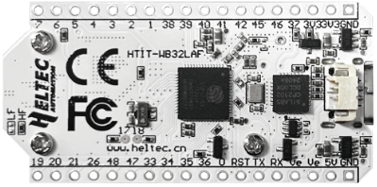
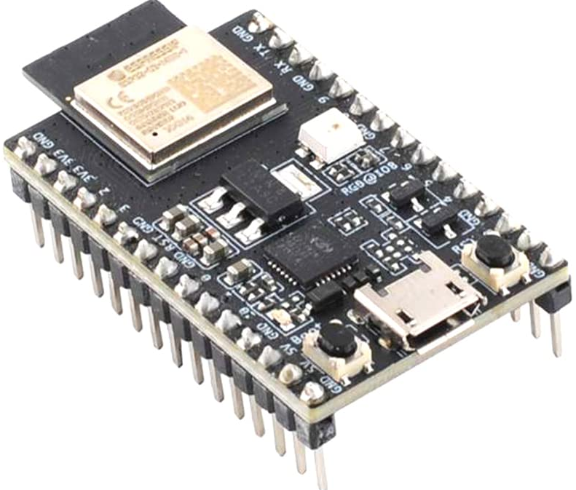
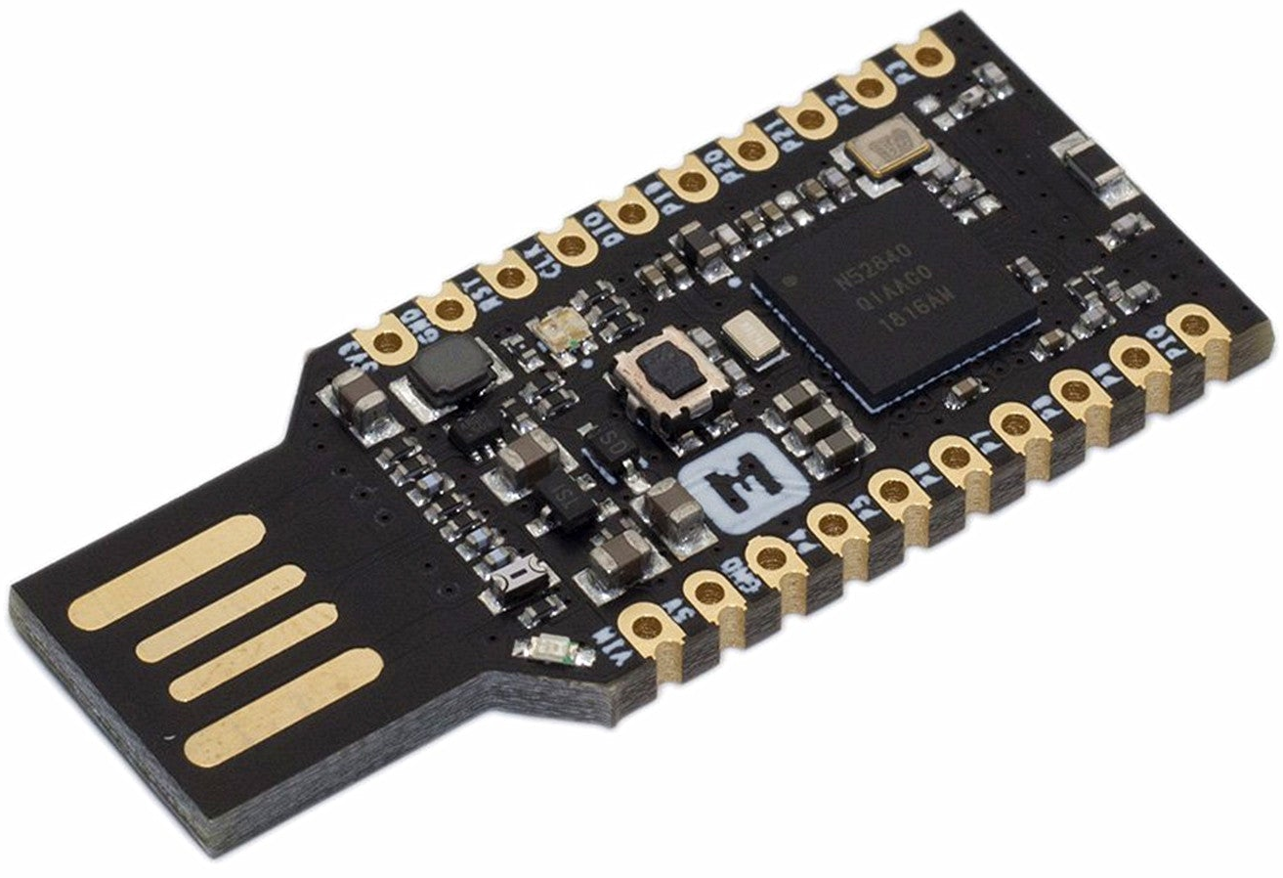
What Have I Done This Week
Met Online With Client
  Gave updates into current SOTA
  Summarized research conducted
Brainstormed & Researched Microcontrollers
  Opt 1 - Heltec WiFi LoRa v3
  Opt 2 - ESP32-C3
  Opt 3 - nRF52840
Wrote Technical Report in CW 18

Slide 3
Did I Do What I Say I Would Do?
Yes, I feel that I met my promises this past week. There is nothing outstanding where I am holding my group back from making progress.
I have attended every class so far. I lead the team in technical solution brainstorming.

Slide 4
Plans For Upcoming Week
Continue To:
Continue to Brainstorm Sensors, Power Systems, & Data Acquisition Strategies
Communicate with Team Members
By EOW:
Work on Gate Report
Continue To Research / Become Expert On Trailer Couplers & Kingpins

